Slide 1
Housing Price Project

Slide 2
Problem Statement
A US-based housing company named Surprise Housing has decided to enter the Australian market. The company uses data analytics to purchase houses at a price below their actual values and flip them at a higher price. For the same purpose, the company has collected a data set from the sale of houses in Australia. Now we have to analyse this dataset of independent variables, create a model and predict the price of a house depending on its independent variable values.

Slide 3
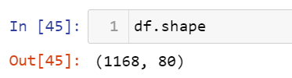
Exploratory Data Analysis
Shape of the data:
This is a small data with 1168 rows and 81 columns.
Null values present:
The dataset has many null values.

Slide 4
Analysing relationship between features

Slide 5
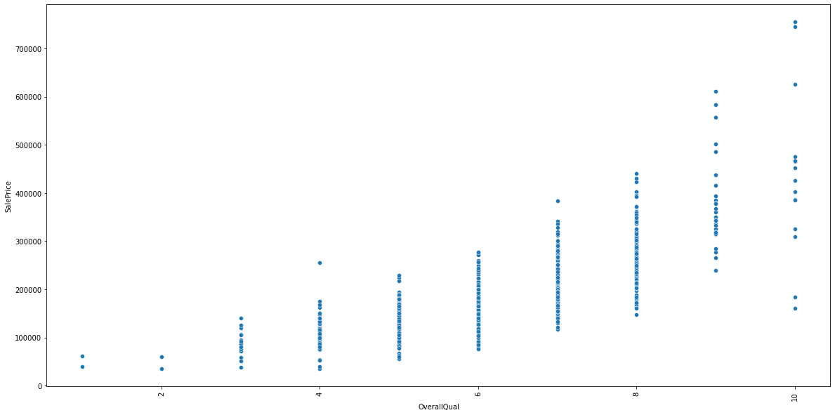
Here we can see that overall quality of a house has linear effect on its price.

Slide 6
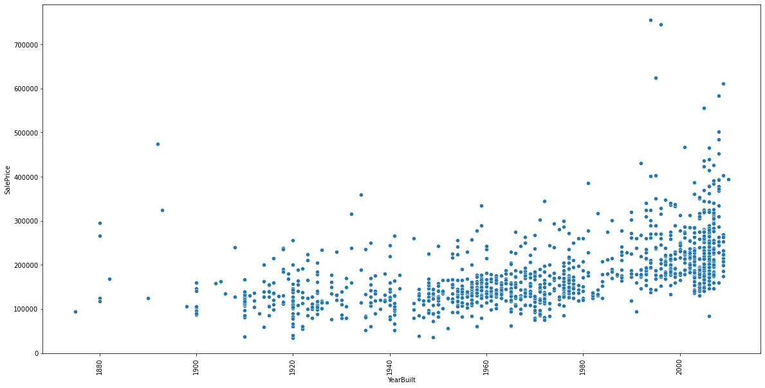
YearBuilt is also linearly related with sale price means newer the house higher its price

Slide 7
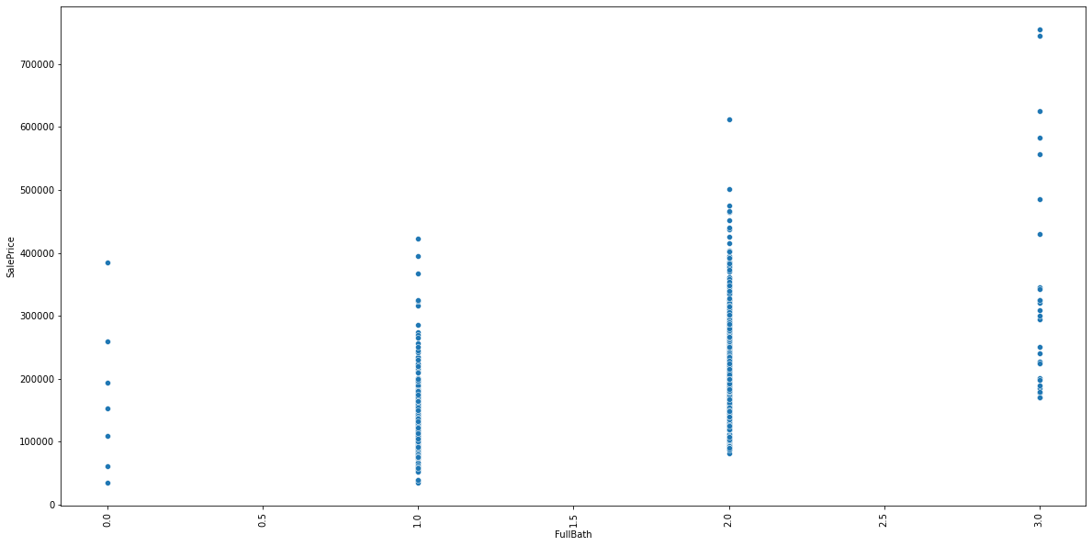
FullBath also positively affects the sales price of house

Slide 8
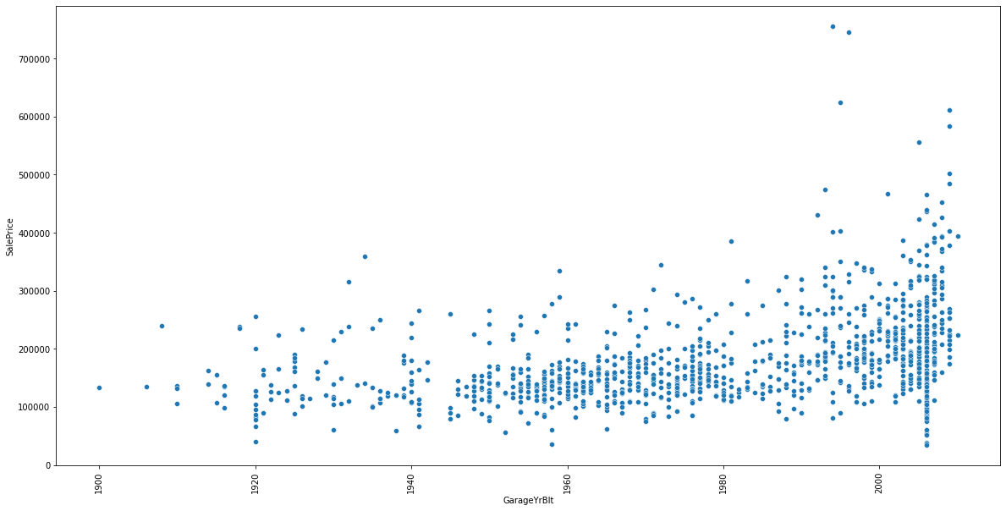
Latest the garage built higher is the house price.

Slide 9
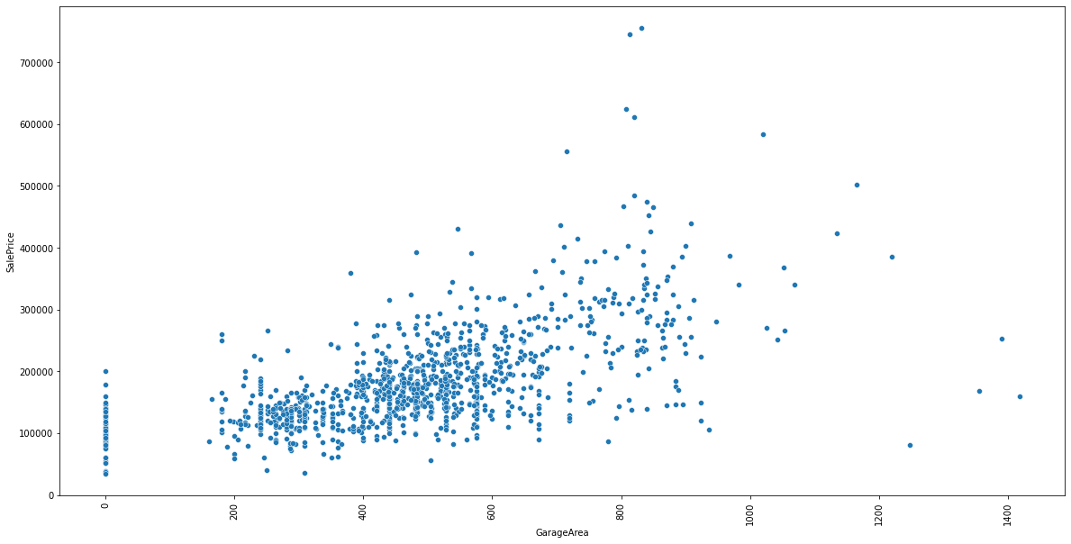
Garage Area affects price positively.

Slide 10
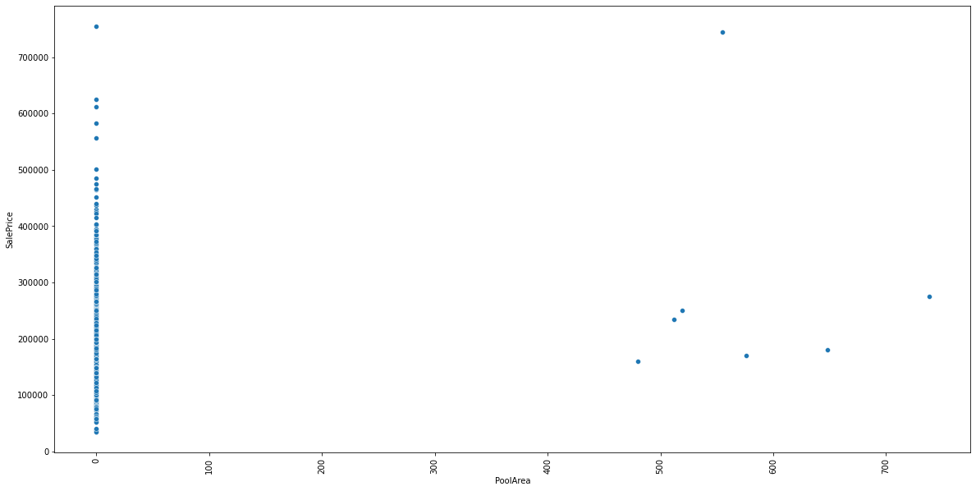
PoolArea doesn’t have any impact on house price.

Slide 11
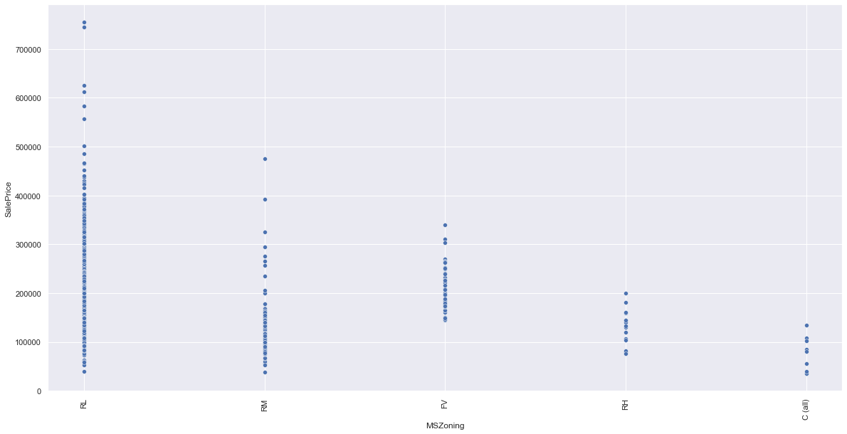
MSZoning is negatively related to sales price

Slide 12
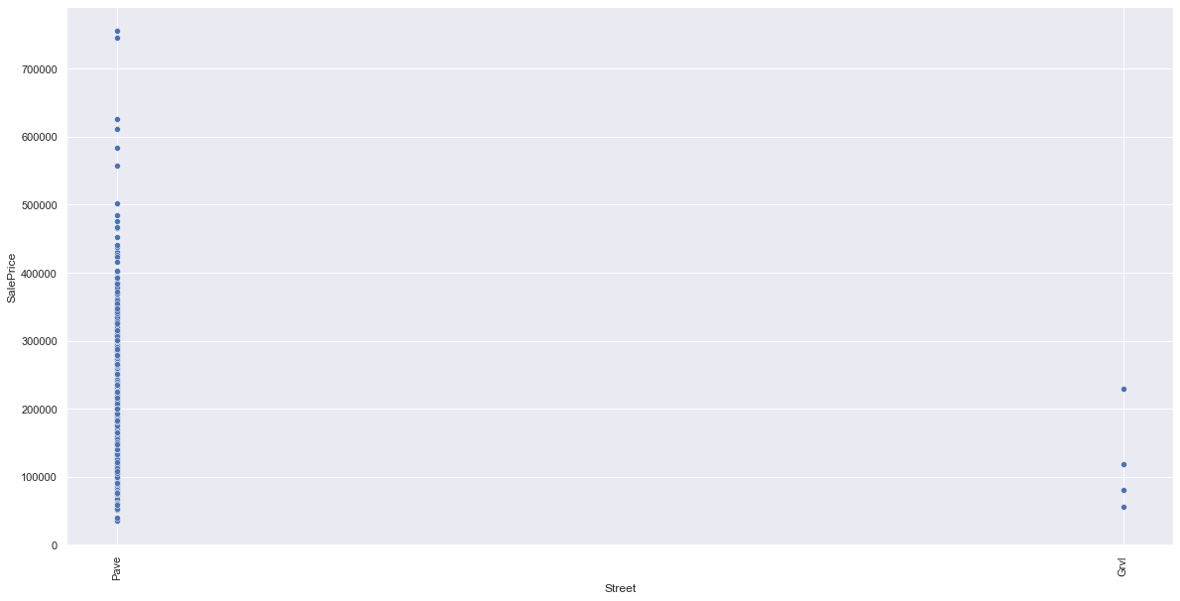
Houses with paved streets are more costly then gravel.

Slide 13
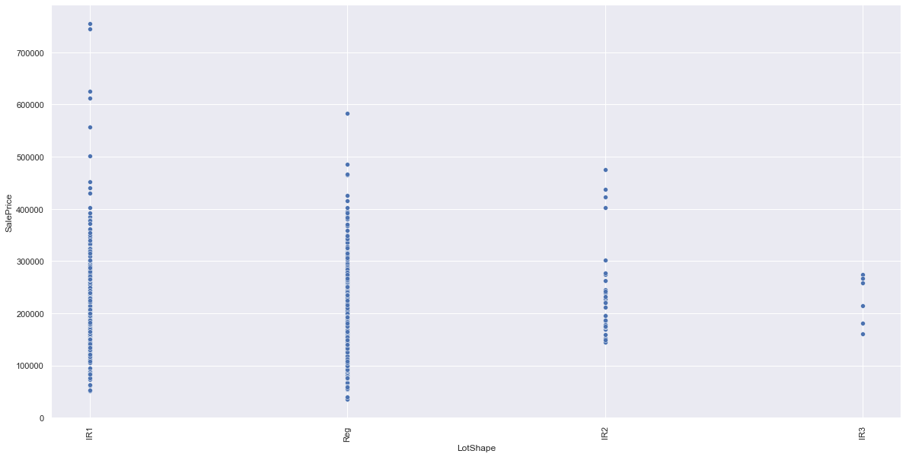
Higher the price if lot shape is IR1.

Slide 14
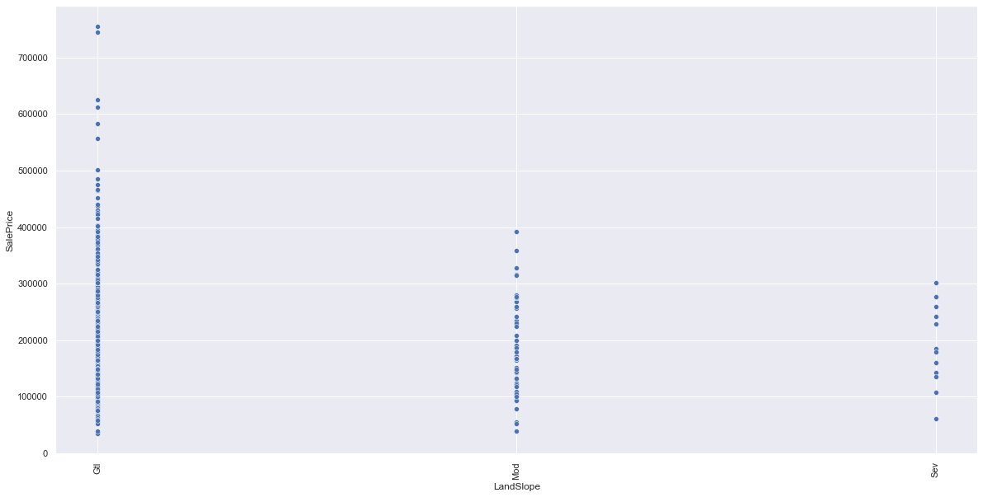
Its is negative linearly related with salesprice.

Slide 15
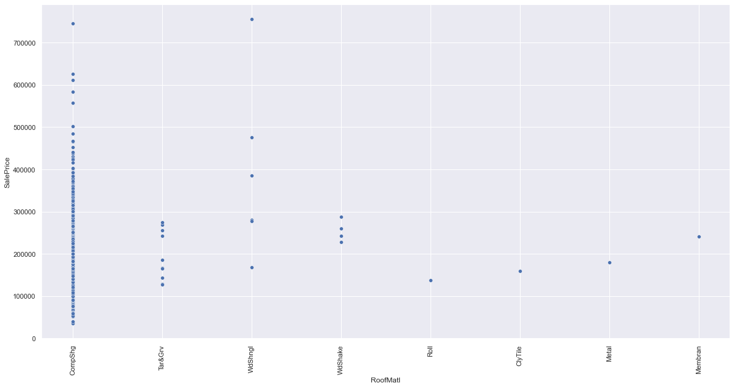
Compshg roofmatl has higher house prices as compared to others.

Slide 16
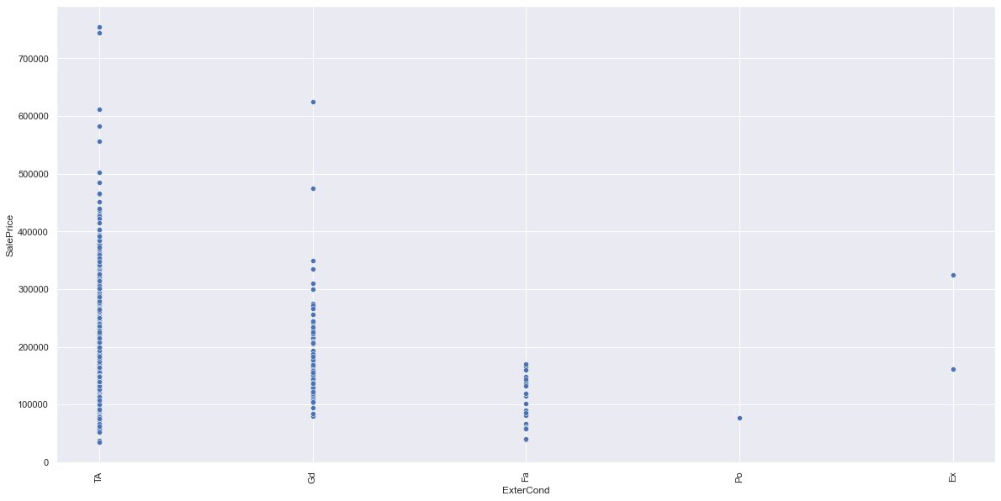
If the exterior has TA then higher the price.

Slide 17
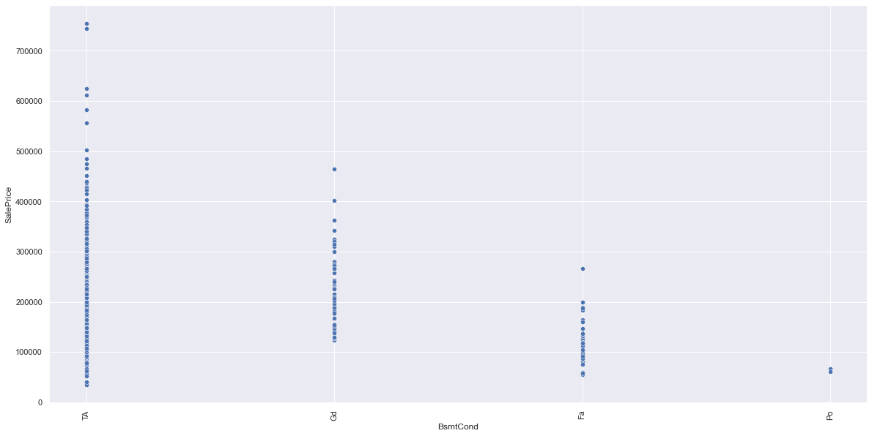
It is also negatively related with sales price.

Slide 18
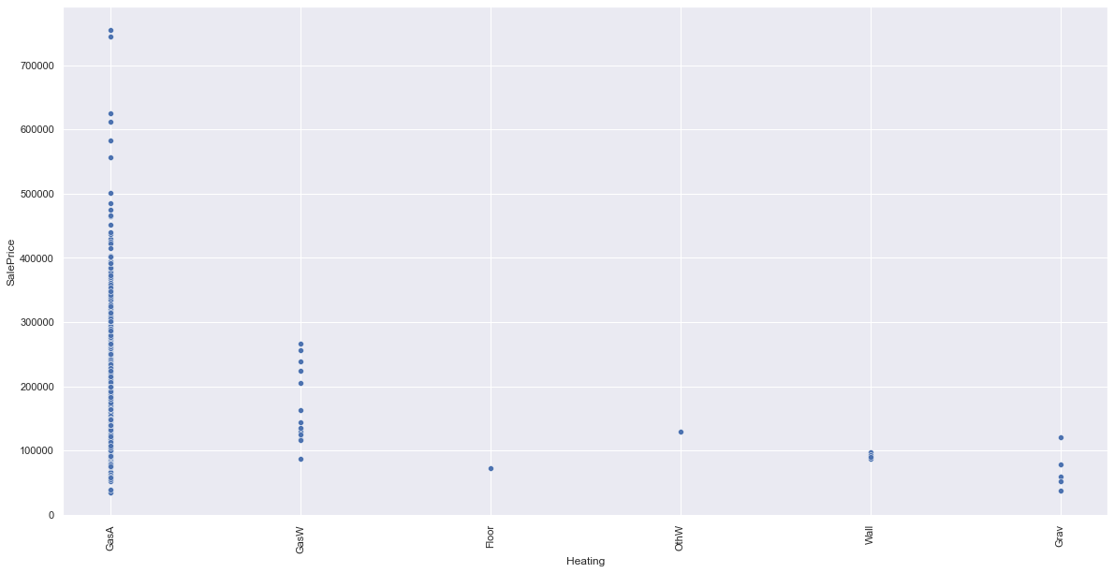
If heating is GasA, so highest the house price.

Slide 19
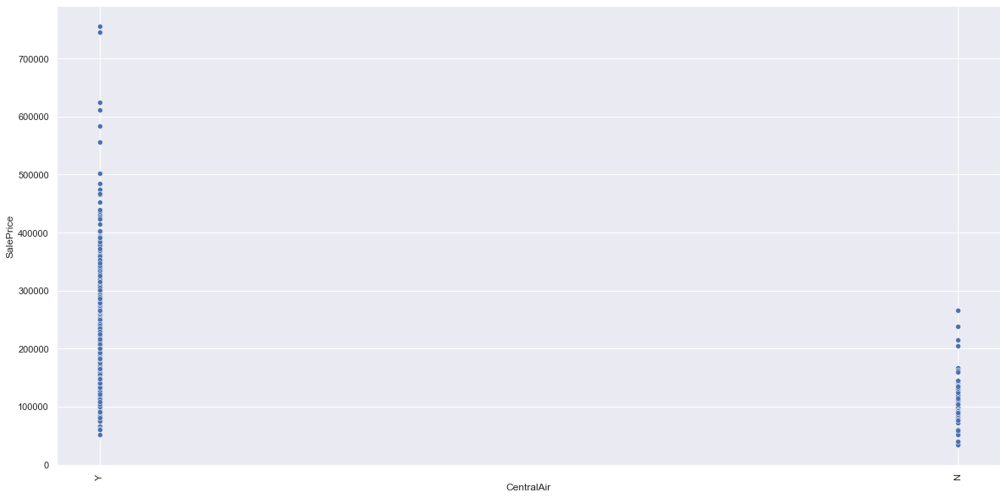
If the house is centrally air conditioned then higher the price.

Slide 20
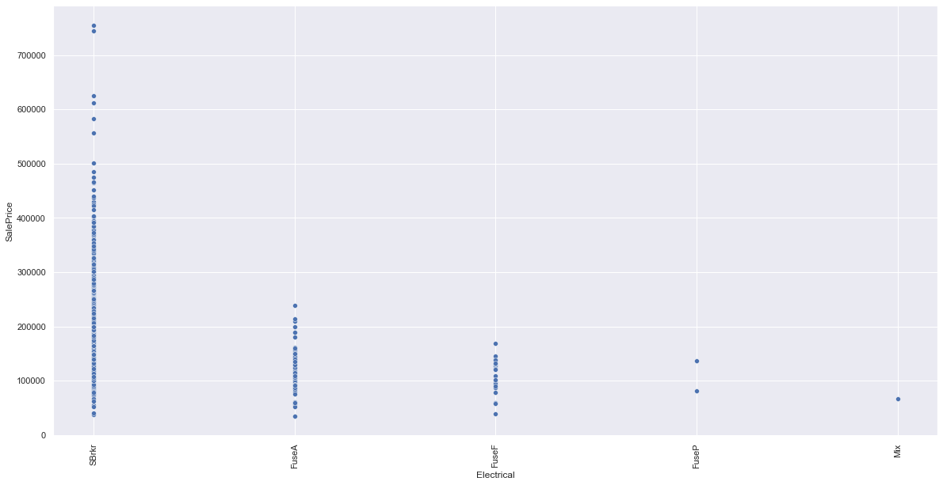
Electrical is negatively related to sales price.

Slide 21
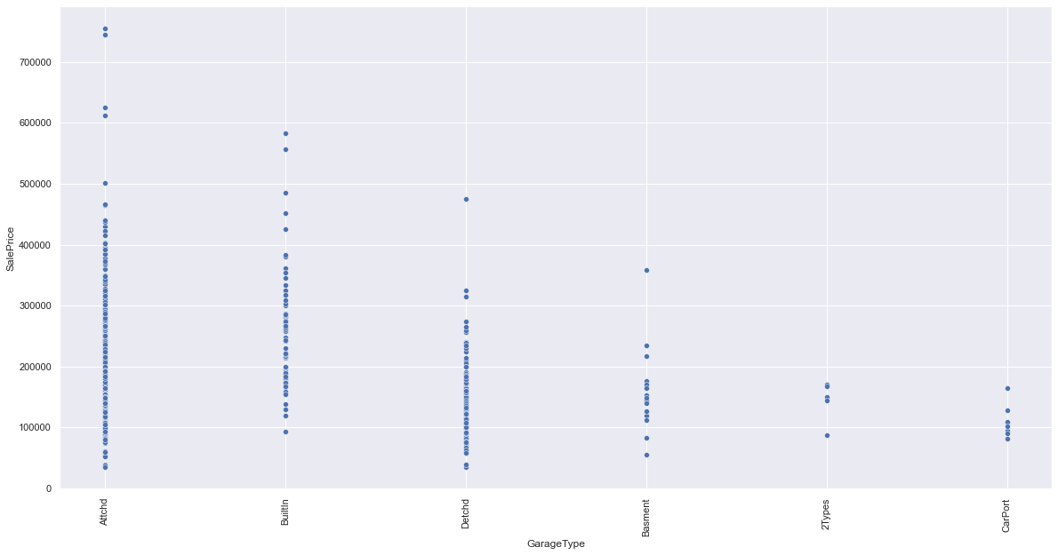
Attached garage has higher the house price.

Slide 22
Conclusion

Slide 23
I found out that the key factors for the house sales price are the lot area, year of establishment, garage, exterior work, streets, electrical work, heating, centrally airconditioned, basements.

